Slide 1






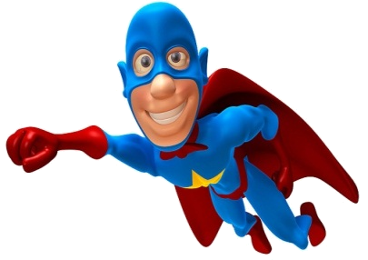


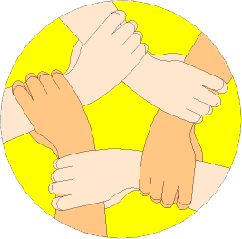
Which ones are you using?
Positive Thinker
Creative Entrepreneur
Independent Learner
Reflective Learner
Responsible Citizen
Team Worker
Enterprise Skills
LESSON OBJECTIVES
We are learning to:
Enhance our Mathematical learning skills.
(Which Enterprise skills?)
Accurately translate objects by instruction and vectors. (Levels 5-6)
Always aim high!
Where are we in our journey?
Real life cross/curricular links?
AUTHOR

Slide 2
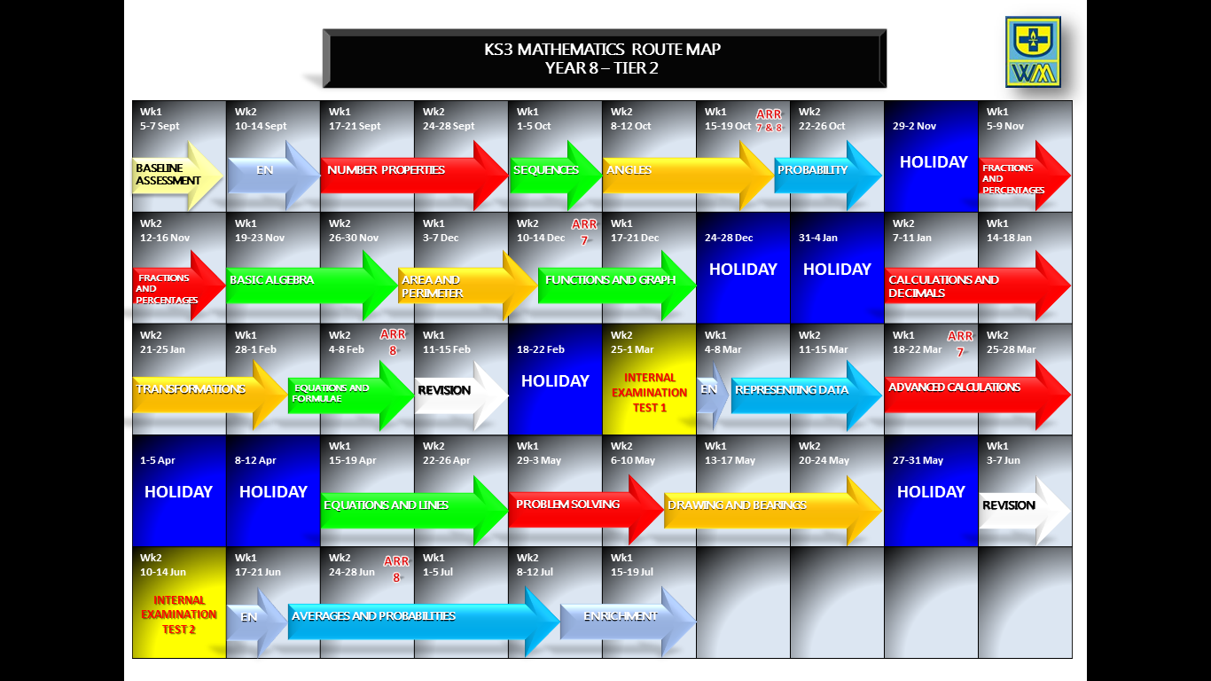
Positive Thinker
Creative Entrepreneur
Independent Learner
Reflective Learner
Responsible Citizen
Team Worker
LEARNING JOURNEY
Enterprise Skills
Which ones are you using?

Slide 3
Positive Thinker
Creative Entrepreneur
Independent Learner
Reflective Learner
Responsible Citizen
Team Worker
BRAIN IN GEAR
Enterprise Skills
Which ones are you using?
EXAMPLE
DITDIONA can be rearranged to make ADDITION
TASK
Work out the following Mathematical anagrams:
TORZLIHONA
LAICVERT
REVCOT
Horizontal
Vertical
Vector
EXTENSION
Develop your own Mathematical anagrams as above as a creative entrepreneur.

Slide 4



Positive Thinker
Creative Entrepreneur
Independent Learner
Reflective Learner
Responsible Citizen
Team Worker
STARTER
Enterprise Skills
Which ones are you using?
TASK
EXTENSION
1)
Simplify: 4d – 3e – 9d + 8e
1)
Work out without a calculator: 8.7 x 5.9
-5d
=
+ 5e
=
2)
Round 5.31 to 1d.p
5.3
(a)
29.36
(b)
Round 29.356 to 2d.p
=
8
7
x
3)
Value of 4d - 9 when d = -5
=
=
-29
4 x -5 - 9
-20 - 9
=
Replace d with -5
5
3
1
1
4
3
1
5
5
4 2 . 6
- 2 7 . 8 2
8 . 3 7
+ 1 4 . 8
0
4)
0
5)
1
1
0
5
0
1
1
7
6
9
2
3
.
1
7
1
4
.
7
8
1
1
2
3
6)
1
2
0
4
Answer = 1204
3
3
8
9 6 3 2
1
3
7)
8(y - 5) – 10
Expand and simplify:
=
8y
- 40
- 10
ANSWER = 51.33
8y - 50
=

Slide 5
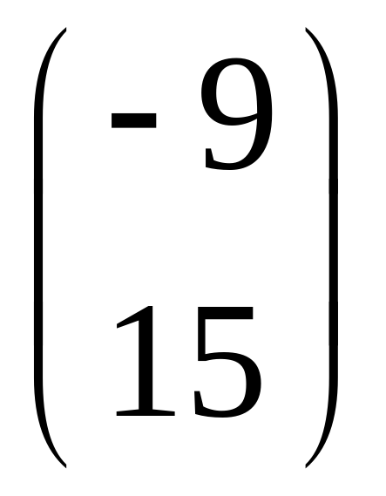
Positive Thinker
Creative Entrepreneur
Independent Learner
Reflective Learner
Responsible Citizen
Team Worker
TRANSLATIONS
Enterprise Skills
Which ones are you using?
INTRODUCTION
TRANSLATION
Moves a shape from one place to another
One thing you need to know
(
)
x
1) Vector
y
Movement left or right and up or down
The top number tells you how many squares across you go (positive for right, negative for left)
The bottom number tells you how many squares up or down you go (positive for up, negative for down)

Slide 6
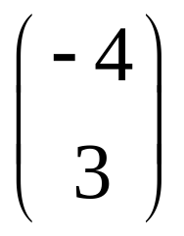

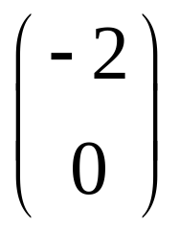
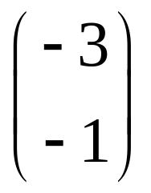
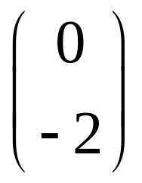
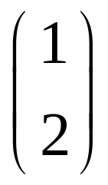

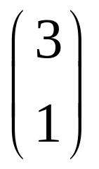
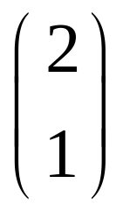
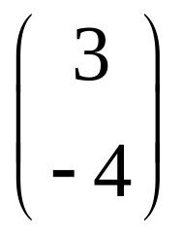
Positive Thinker
Creative Entrepreneur
Independent Learner
Reflective Learner
Responsible Citizen
Team Worker
TRANSLATIONS
Enterprise Skills
Which ones are you using?
INTRODUCTION

Slide 7
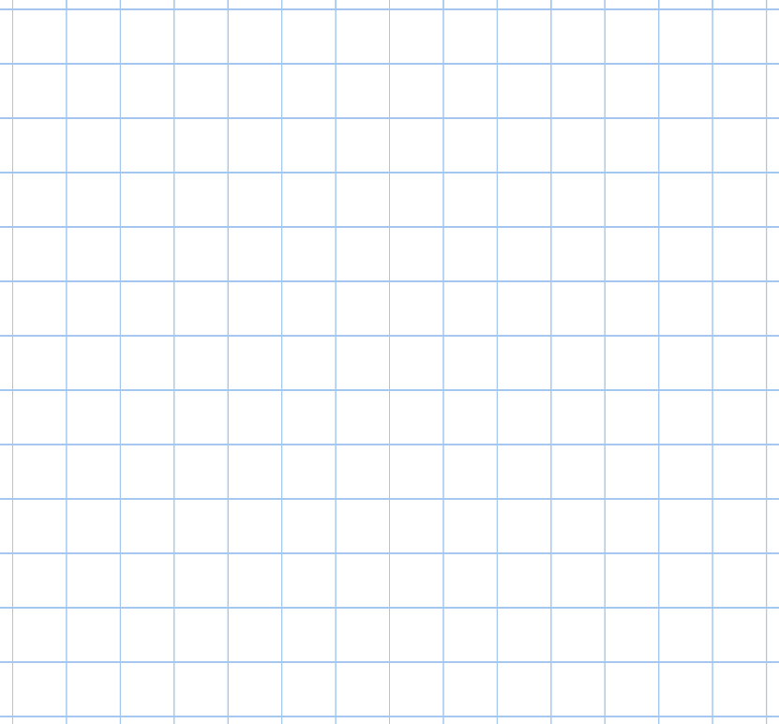


Positive Thinker
Creative Entrepreneur
Independent Learner
Reflective Learner
Responsible Citizen
Team Worker
Enterprise Skills
Which ones are you using?
TRANSLATION OF SHAPES
EXAMPLES
1)
8
8
2)
5
5
8
8
6
6
5
5
7
7
6
6
7
7
Translate this shape 8 units right and 6 units down
Translate this shape 5 units left and 7 units down

Slide 8

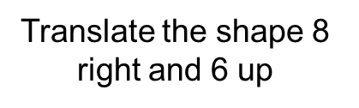
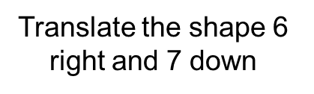
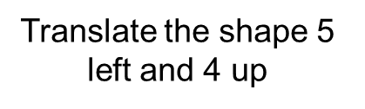
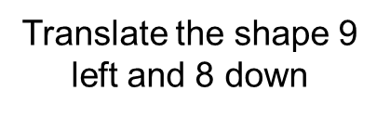


Positive Thinker
Creative Entrepreneur
Independent Learner
Reflective Learner
Responsible Citizen
Team Worker
Enterprise Skills
Which ones are you using?
TRANSLATION OF SHAPES
TASK 1 (LEVEL 5)
1)
2)
3)
6
6
6
6
7
4
4
6
6
7
7
5
5
8
4
8
8
5
4)
9
9
5)
6)
9
9
3
3
8
8
1
1
3
3
8
8
1
1

Slide 9
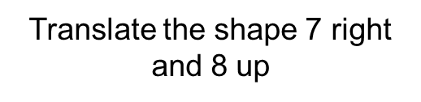
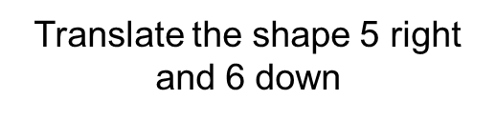

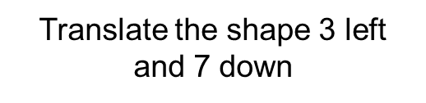


Positive Thinker
Creative Entrepreneur
Independent Learner
Reflective Learner
Responsible Citizen
Team Worker
Enterprise Skills
Which ones are you using?
TRANSLATION OF SHAPES
EXTENSION 1 (LEVEL 5)
1)
2)
5
3)
5
5
5
6
8
8
5
6
5
5
6
6
5
5
8
8
5
5
6
10
8
8
6
7
7
5
5
10
10
10
10
7
7
10
7
7
10
4)
3
5)
6)
3
3
3
3
3
3
3
3
3
3
3
3
7
3
7
2
2
3
7
7
7
7
2
3
7
7
7
7
2
3
7
7
2
3

Slide 10
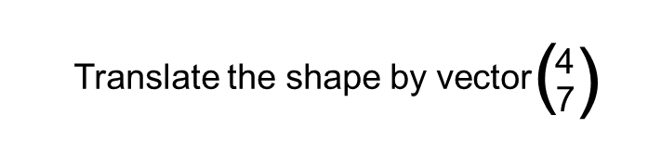
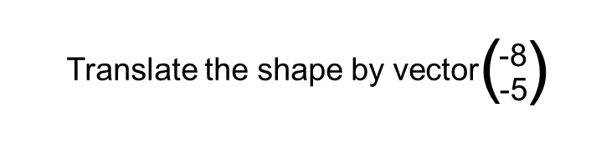
Positive Thinker
Creative Entrepreneur
Independent Learner
Reflective Learner
Responsible Citizen
Team Worker
Enterprise Skills
Which ones are you using?
TRANSLATION OF SHAPES
EXAMPLES
3)
4)
8
8
5
5
8
8
7
7
5
5
7
7
4
4
4
4
4 right
8 left
7 up
5 down

Slide 11
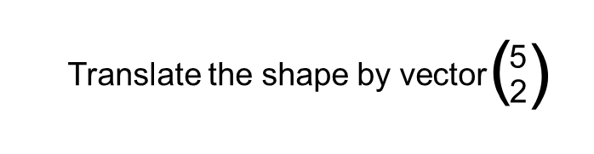
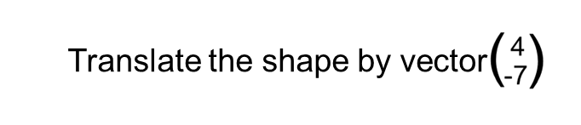
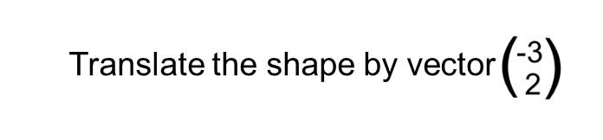
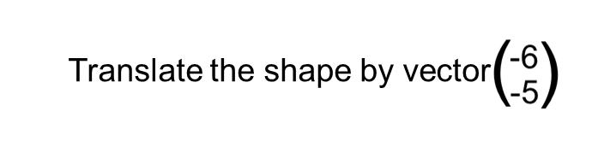
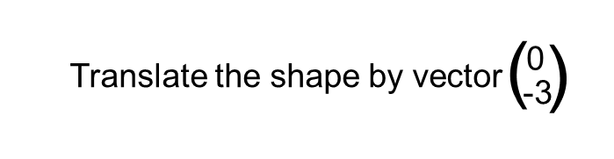
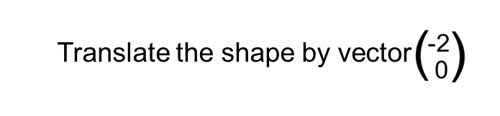
Positive Thinker
Creative Entrepreneur
Independent Learner
Reflective Learner
Responsible Citizen
Team Worker
Enterprise Skills
Which ones are you using?
TRANSLATION OF SHAPES
TASK 2 (LEVEL 6)
1)
2)
4
4
3)
4
7
7
2
5
2
2
2
2
7
3
3
5
5
2
3
4)
6
6
5)
6)
5
5
6
6
2
2
3
3
5
5
3
3
2
2

Slide 12
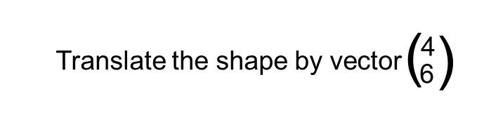
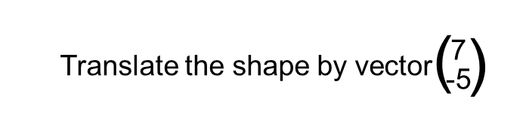
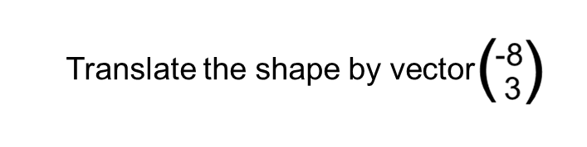
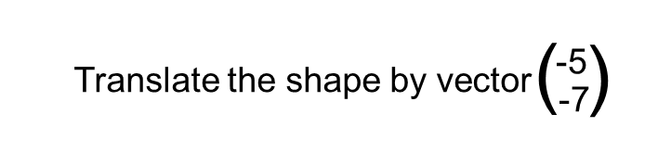
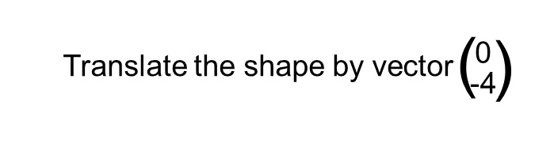
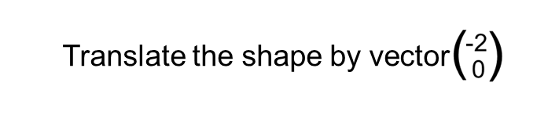
Positive Thinker
Creative Entrepreneur
Independent Learner
Reflective Learner
Responsible Citizen
Team Worker
Enterprise Skills
Which ones are you using?
TRANSLATION OF SHAPES
EXTENSION 2 (LEVEL 6)
1)
2)
3)
7
7
7
7
6
6
5
5
3
7
7
5
5
3
3
3
6
6
3
8
5
6
6
5
8
8
8
8
3
3
4
8
8
4)
5)
6)
5
5
5
5
5
5
5
5
5
5
5
2
7
5
7
2
7
7
7
7
2
7
4
4
7
7
7
2
7
4
7
2
4
2
4

Slide 13
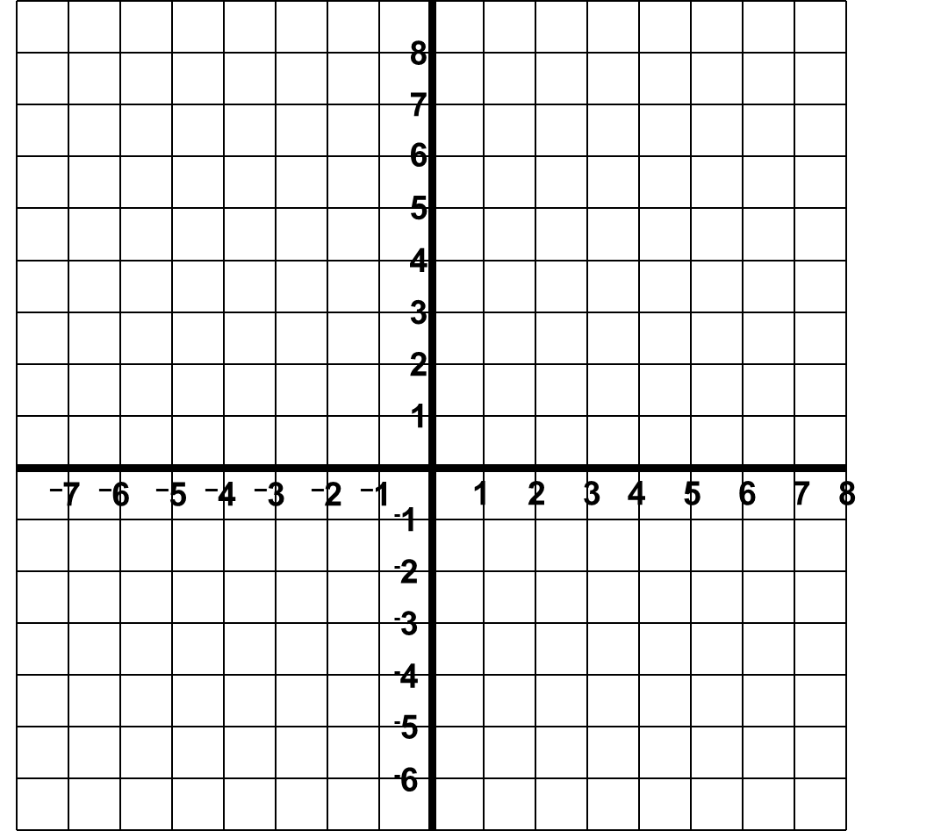
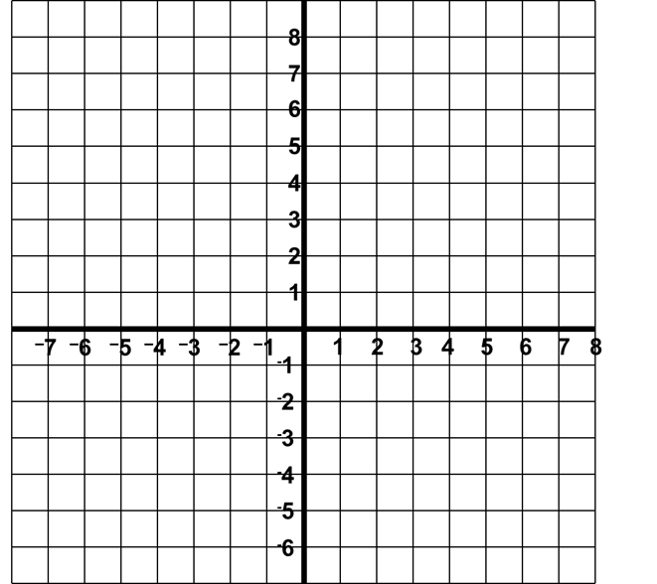



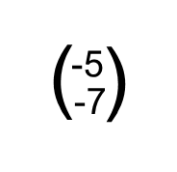
Positive Thinker
Creative Entrepreneur
Independent Learner
Reflective Learner
Responsible Citizen
Team Worker
Enterprise Skills
Which ones are you using?
TRANSLATION OF SHAPES
EXAMPLES
5)
6)
5
5
5
5
5
5
5
5
5
5
7
7
5
5
10
10
7
7
7
7
7
7
7
7
10
10
7
7
9
9
9
9
9 right
5 left
Translate the shape by vector
Translate the shape by vector
10 up
7 down

Slide 14
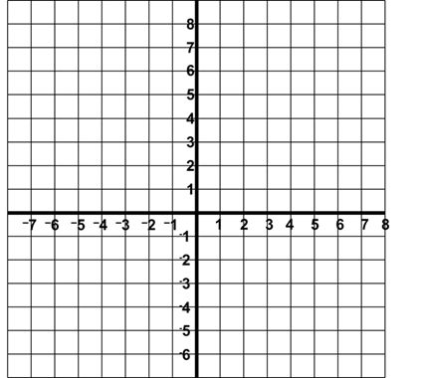
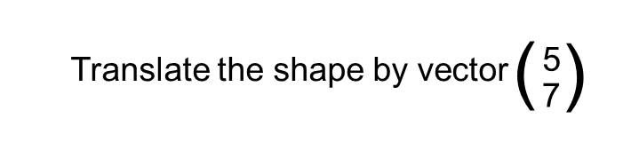
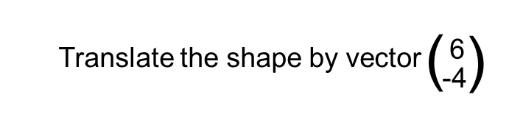
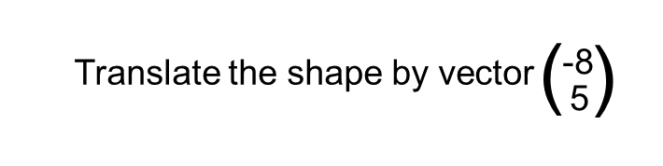
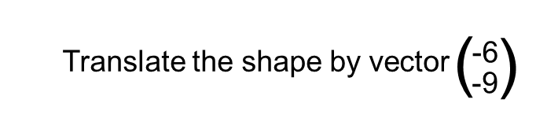
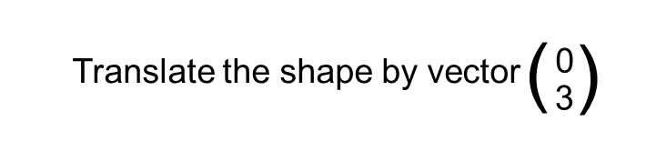
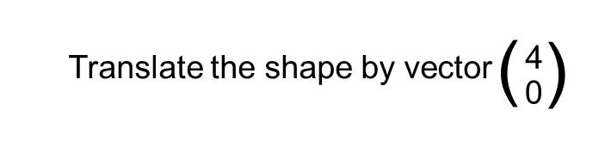
Positive Thinker
Creative Entrepreneur
Independent Learner
Reflective Learner
Responsible Citizen
Team Worker
Enterprise Skills
Which ones are you using?
TRANSLATION OF SHAPES
TASK 3 (LEVEL 6)
1)
2)
3)
6
6
4
6
4
7
4
5
7
7
5
5
8
5
5
5
8
8
4)
6
6
5)
6)
6
6
3
9
9
4
3
4
9
9
3
4
4
3

Slide 15
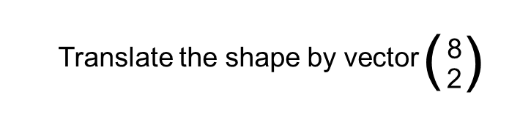
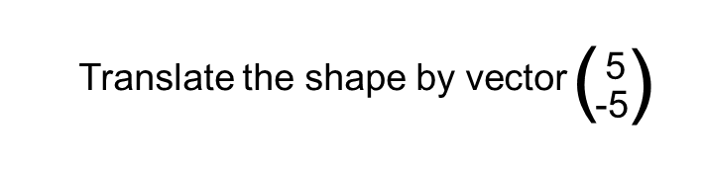
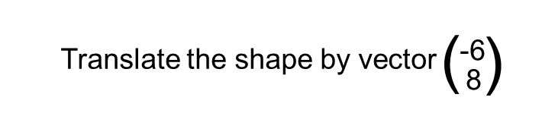
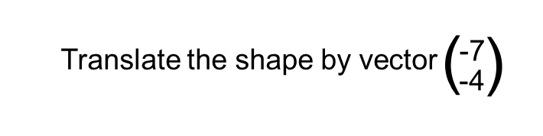
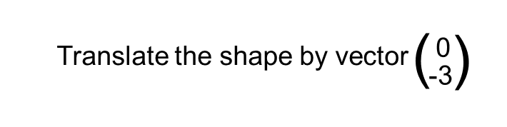
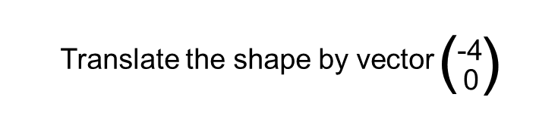
Positive Thinker
Creative Entrepreneur
Independent Learner
Reflective Learner
Responsible Citizen
Team Worker
Enterprise Skills
Which ones are you using?
TRANSLATION OF SHAPES
EXTENSION 3 (LEVEL 6)
1)
2)
5
3)
5
5
5
5
5
5
5
8
5
5
8
8
2
8
8
8
2
8
8
6
8
6
2
6
8
2
8
2
2
6
8
8
6
6
6
4)
5)
6)
4
7
3
4
7
3
4
4
7
7
4
4
3
3
4
4
4
7
7
3
3
4
4
3
4
4
4
4
3
4
4

Slide 16
Positive Thinker
Creative Entrepreneur
Independent Learner
Reflective Learner
Responsible Citizen
Team Worker
Enterprise Skills
Which ones are you using?
TRANSLATION OF SHAPES
EXAMPLES
7)
8)
B
B
A
3
10
7
A
8
Describe the transformation fully that takes shape A to shape B.
Describe the transformation fully that takes shape A to shape B.
(
)
(
)
10
-8
Translation
by vector
Translation
by vector
3
7

Slide 17







Positive Thinker
Creative Entrepreneur
Independent Learner
Reflective Learner
Responsible Citizen
Team Worker
Enterprise Skills
Which ones are you using?
TRANSLATION OF SHAPES
TASK 4 (LEVEL 6)
1)
2)
3)
9
B
A
7
B
8
B
6
A
A
10
5
4)
5)
6)
A
A
B
A
10
4
B
8
6
B

Slide 18

Positive Thinker
Creative Entrepreneur
Independent Learner
Reflective Learner
Responsible Citizen
Team Worker
Enterprise Skills
Which ones are you using?
TRANSLATION OF SHAPES
MINI-PLENARY – TRUE OR FALSE
STAND UP → TRUE
SIT DOWN → FALSE
The transformation from A to B is a translation by vector
B
(
)
-6
-1
1
FALSE
6
A
(
)
Translation
6
1

Slide 19
Positive Thinker
Creative Entrepreneur
Independent Learner
Reflective Learner
Responsible Citizen
Team Worker
Enterprise Skills
Which ones are you using?
TRANSLATION OF SHAPES
MINI-PLENARY – TRUE OR FALSE
STAND UP → TRUE
SIT DOWN → FALSE
5
A
3
The transformation from A to B is a translation by vector
(
)
B
-5
-3
TRUE
(
)
Translation
-5
-3

Slide 20
Positive Thinker
Creative Entrepreneur
Independent Learner
Reflective Learner
Responsible Citizen
Team Worker
Enterprise Skills
Which ones are you using?
TRANSLATION OF SHAPES
MINI-PLENARY – TRUE OR FALSE
STAND UP → TRUE
SIT DOWN → FALSE
A
The transformation from A to B is a translation by vector
(
)
-8
0
FALSE
(
)
Translation
0
8
-8
B

Slide 21
Positive Thinker
Creative Entrepreneur
Independent Learner
Reflective Learner
Responsible Citizen
Team Worker
Enterprise Skills
Which ones are you using?
TRANSLATION OF SHAPES
MINI-PLENARY – TRUE OR FALSE
STAND UP → TRUE
SIT DOWN → FALSE
The transformation from A to B is a translation by vector
6
(
)
-6
B
0
A
TRUE
(
)
Translation
-6
0

Slide 22
Positive Thinker
Creative Entrepreneur
Independent Learner
Reflective Learner
Responsible Citizen
Team Worker
DISCOVERY
Enterprise Skills
Which ones are you using?
LINK BACK TO OBJECTIVES
Accurately translate objects by instruction and vectors.
What level are we working at?

Slide 23

Positive Thinker
Creative Entrepreneur
Independent Learner
Reflective Learner
Responsible Citizen
Team Worker
Enterprise Skills
Which ones are you using?
TRANSLATION OF SHAPES
PLENARY ACTIVITY
What letter would you get if you translate each shape by it’s vector?

Slide 24

Positive Thinker
Creative Entrepreneur
Independent Learner
Reflective Learner
Responsible Citizen
Team Worker
Enterprise Skills
Which ones are you using?
TRANSLATION OF SHAPES
PLENARY ACTIVITY
What letter would you get if you translate each shape by it’s vector?

Slide 25



Positive Thinker
Creative Entrepreneur
Independent Learner
Reflective Learner
Responsible Citizen
Team Worker
SELF ASSESSMENT
Enterprise Skills
Which ones are you using?
What have you learnt?
Draw your brain
In your brain, write or draw everything you can remember about translating objects by instruction and vectors. It can be a skill or a reflection, or something else that might be prominent in your brain.
Where are we in our journey?
What level are we working at?

Slide 26



Positive Thinker
Creative Entrepreneur
Independent Learner
Reflective Learner
Responsible Citizen
Team Worker
SELF ASSESSMENT
Enterprise Skills
Which ones are you using?
Plenary Activity
How well do you understand the task?
.
I don’t understand
I nearly understand
I fully understand

Slide 27




Positive Thinker
Creative Entrepreneur
Independent Learner
Reflective Learner
Responsible Citizen
Team Worker
SELF ASSESSMENT
Enterprise Skills
Which ones are you using?
Plenary Activity
WWW (What Went Well)
EBI (Even Better If)
On your post it notes…
Think about how you can improve your work.

Slide 28
Positive Thinker
Creative Entrepreneur
Independent Learner
Reflective Learner
Responsible Citizen
Team Worker
Enterprise Skills
Which ones are you using?
TRANSLATION OF SHAPES
TASK 1 (LEVEL 5)
1)
2)
3)
4)
5)
6)

Slide 29
Positive Thinker
Creative Entrepreneur
Independent Learner
Reflective Learner
Responsible Citizen
Team Worker
Enterprise Skills
Which ones are you using?
TRANSLATION OF SHAPES
EXTENSION 1 (LEVEL 5)
1)
2)
3)
4)
5)
6)

Slide 30
Positive Thinker
Creative Entrepreneur
Independent Learner
Reflective Learner
Responsible Citizen
Team Worker
Enterprise Skills
Which ones are you using?
TRANSLATION OF SHAPES
TASK 2 (LEVEL 6)
1)
2)
3)
4)
5)
6)

Slide 31
Positive Thinker
Creative Entrepreneur
Independent Learner
Reflective Learner
Responsible Citizen
Team Worker
Enterprise Skills
Which ones are you using?
TRANSLATION OF SHAPES
EXTENSION 2 (LEVEL 6)
1)
2)
3)
4)
5)
6)

Slide 32
Positive Thinker
Creative Entrepreneur
Independent Learner
Reflective Learner
Responsible Citizen
Team Worker
Enterprise Skills
Which ones are you using?
TRANSLATION OF SHAPES
TASK 3 (LEVEL 6)
1)
2)
3)
4)
5)
6)

Slide 33
Positive Thinker
Creative Entrepreneur
Independent Learner
Reflective Learner
Responsible Citizen
Team Worker
Enterprise Skills
Which ones are you using?
TRANSLATION OF SHAPES
EXTENSION 3 (LEVEL 6)
1)
2)
4)
5)
6)

Slide 34
Positive Thinker
Creative Entrepreneur
Independent Learner
Reflective Learner
Responsible Citizen
Team Worker
Enterprise Skills
Which ones are you using?
TRANSLATION OF SHAPES
TASK 4 (LEVEL 6)
1)
2)
3)
B
A
B
B
A
A
4)
5)
6)
A
A
B
A
B
B

Slide 35
Positive Thinker
Creative Entrepreneur
Independent Learner
Reflective Learner
Responsible Citizen
Team Worker
Enterprise Skills
Which ones are you using?
TRANSLATION OF SHAPES
PLENARY ACTIVITY
What letter would you get if you translate each shape by it’s vector?

Slide 36
Positive Thinker
Creative Entrepreneur
Independent Learner
Reflective Learner
Responsible Citizen
Team Worker
Enterprise Skills
Which ones are you using?
TRANSLATION OF SHAPES
PLENARY ACTIVITY
What letter would you get if you translate each shape by it’s vector?

